Slide 1
Image inpainting using Deep learning methods
Aiswarya Annem LONGZHUANG LI
Department of Computing Sciences
Texas A&M University-Corpus Christi
Corpus Christi, TX 78412

Slide 2
CONTENTS
Introduction
Related Works
Proposed Framework
Datasets
Differences
References
Performance of Existing Method
Experiments
Conclusion and Future Work

Slide 3
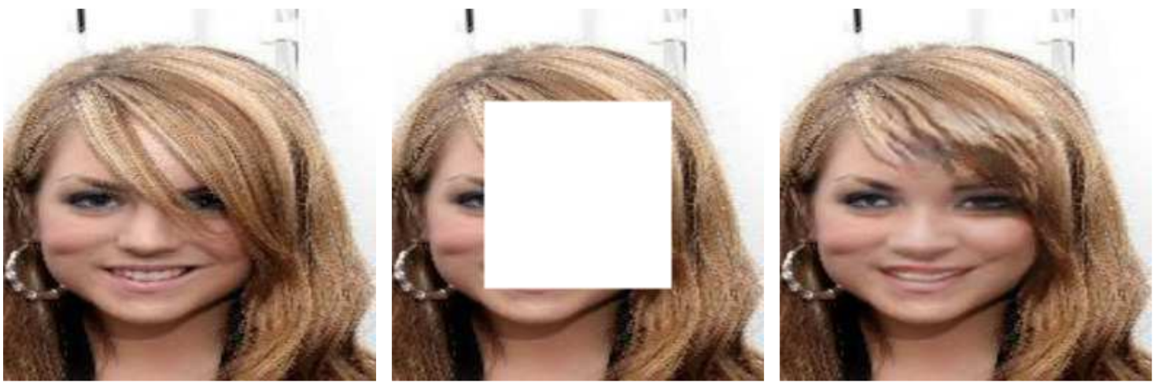
Introduction
Image Inpainting is a technique to reconstruct missing parts or damaged parts of an input image in such a manner that it cannot be distinguished.
Fig 1. Sample example of image inpainting on CelebA dataset

Slide 4
Related Works
Recently many of the image inpainting methods are introduced based on GAN(Generative Adversarial Networks) .
In Yue Zhao et al.[4] the Wasserstein Generative Adversarial Network combined with the perceived loss and context loss function is used to repair the corrupted region of the image.
Utkarsh Maheshwari et al.[3], presents a custom Generative Adversarial Network (GAN) - named Lucid-GAN on top of EdgeConnect to upscale the quality of the image.
To overcome problems of GANs with gradient vanishing and model collapse during training Chong Han et al.[2] proposed a GAN with Evolutionary Generators (EG-GAN).

Slide 5
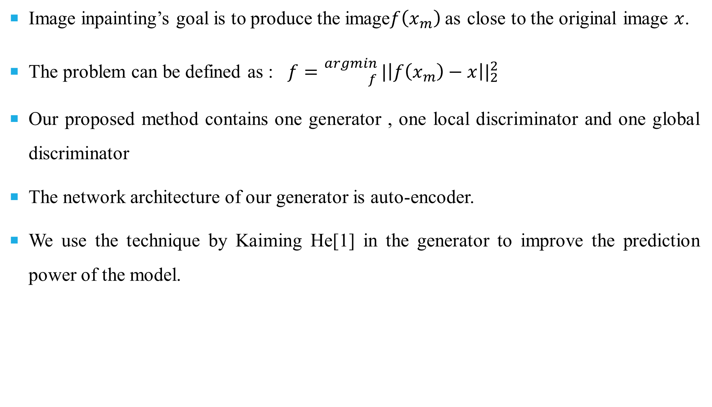
Proposed work
Image inpainting’s goal is to produce the image$f\left(x_{m}\right)$as close to the original image $x$.
The problem can be defined as : $f={}_{f}^{argmin} |\left|f\left(x_{m}\right)−x\right||_{2}^{2}$
Our proposed method contains one generator , one local discriminator and one global discriminator
The network architecture of our generator is auto-encoder.
We use the technique by Kaiming He[1] in the generator to improve the prediction power of the model.

Slide 6
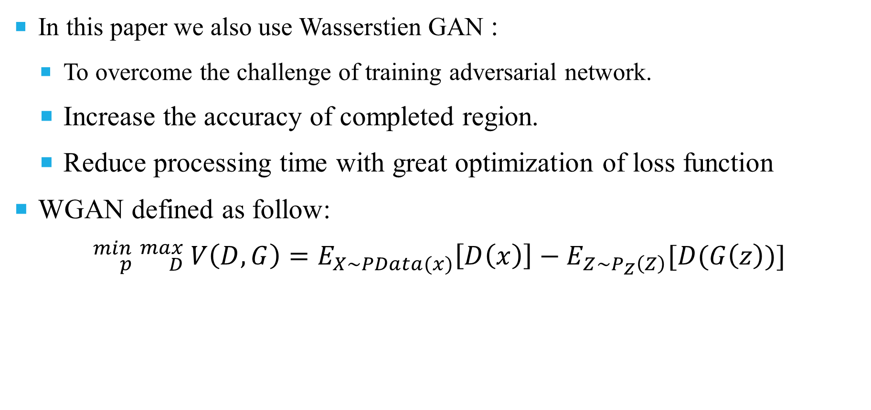
Proposed Work(Cont…)
In this paper we also use Wasserstien GAN :
To overcome the challenge of training adversarial network.
Increase the accuracy of completed region.
Reduce processing time with great optimization of loss function
WGAN defined as follow:
$${}_{p}^{min}{ {}_{D}^{max}{ V\left(D,G\right)=E_{X\sim PData(x)}\left[D\left(x\right)\right]−E_{Z\sim P_{Z}\left(Z\right)}[D(G\left(z\right)})]}$$

Slide 7
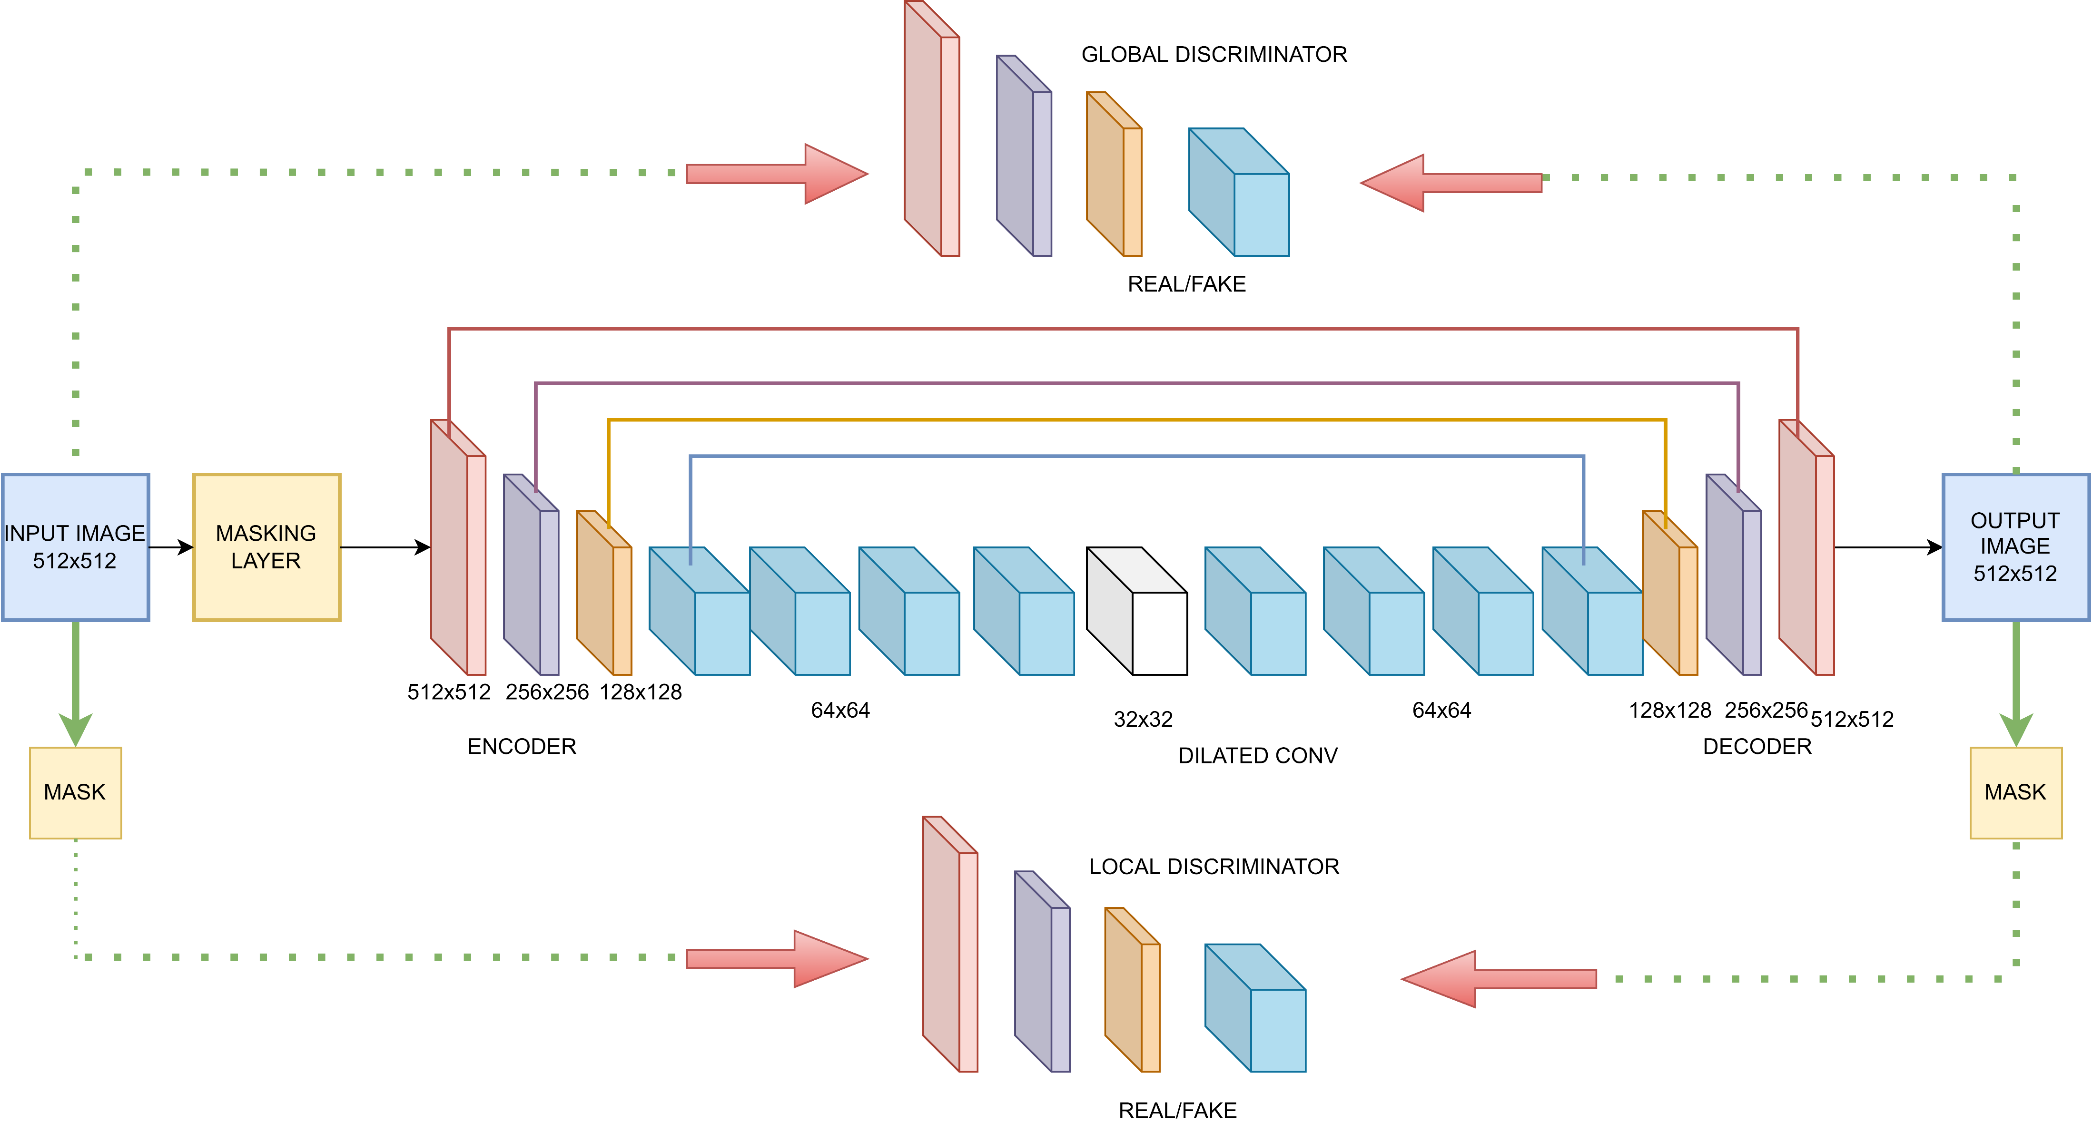
OVERVIEW OF PROPOSED MODEL

Slide 8
Datasets
I have considered three datasets for Image Inpainting to train and evaluate our model:
CelebA
CelebA-HQ
Places2
There are 202599 RGB color facial images in the Celeb A dataset.
Places2, contains over 8,000,000 images from over 365 scenes collected from the natural world.
CelebA-HQ it contains 24102 photos, and it is High-definition human face dataset.

Slide 9
Performance of existing method
Method\Dataset | Metrics | Places2 | Celeb A | CelebA-HQ
EG-GAN | PSNR | - | - | 34.16
 | SSIM | - | - | 0.94
CRN | PSNR | - | - | 28.61
 | SSIM | - | - | 0.901
EDBGAN | PSNR | - | 23.72 | -
 | SSIM | - | 0.866 | -
LEAM | PSNR | 22.26 | - | -
 | SSIM | 0.712 | - | -
Baseline+Edge+Fusion | PSNR | 25.41 | 31.05 | -
 | SSIM | 0.868 | 0.949 | -
DMFLBPN | PSNR | - | - | 28.07
 | SSIM | - | - | 0.893
R-Mnet | PSNR | 39.66 | - | 40.4
 | SSIM | 0.93 | - | 0.94
SACA | PSNR | - | 25.2 | -
 | SSIM | - | 0.85 | -

Slide 10
Differences
Several methods use convolution neural networks for the use case of image inpainting
Other state-of-art techniques use GAN framework to solve the problems seen in CNN but it has shown the problem of gradient vanishing due to deep network.
To overcome gradient vanishing problem by GAN we proposed to use WGAN(Wasserstein General adversarial network) instead.
Using, WGAN not only solves the given problem but stabilizes the training process.
Moreover, we propose to use two discriminators in our network mainly: global discriminator and local discriminator to determine whether generated image is correct and consistent.

Slide 11
Experiments
Our experiment used a face image with a pixel size of 512x512, a training set of 24102 images, and a test set of 2942 images.
Trained on epochs of 100 and training time of 15 hours
Training data was divided into batch of 800 images
Two GTX 1080 Ti GPUs are used, completing the 60-generation cycle
We combined the Kaiming He [6] technique with dilated convolution and our novel loss function to produce better outcomes than state of art methods.
We used eight different square masks. As the mask size grows larger, SSIM and PSNR fall to some amount

Slide 12
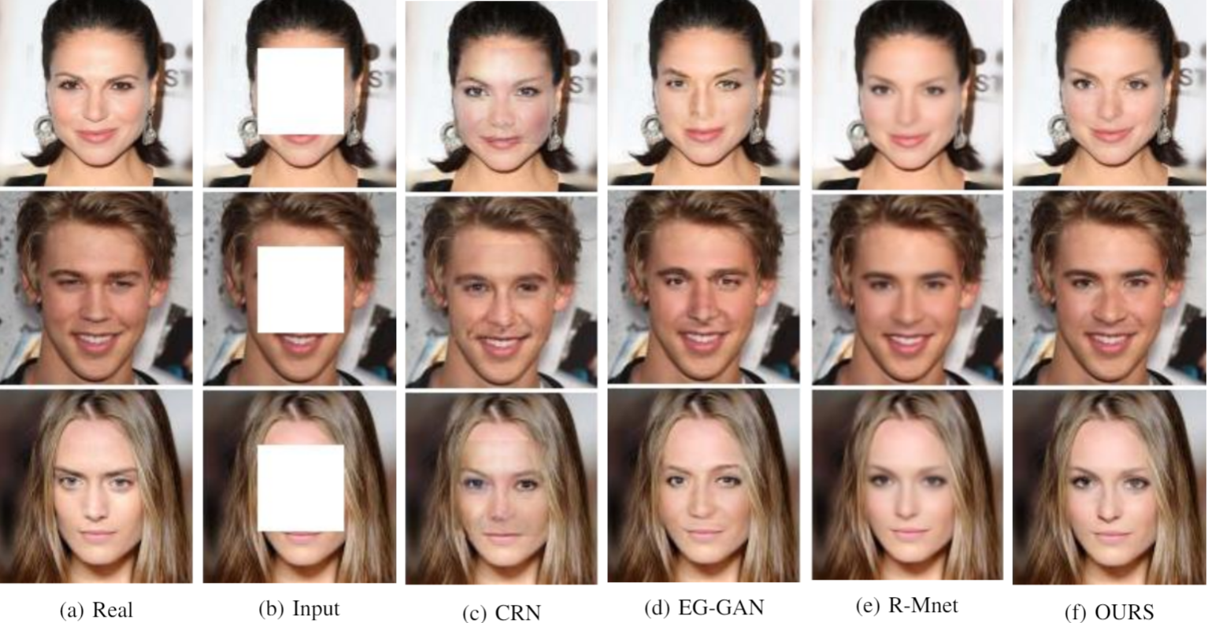
Visual comparison

Slide 13
Comparison with existing methods
Method\Dataset | Metrics | Places2 | Celeb A | CelebA-HQ
EG-GAN | PSNR | - | - | 34.16
 | SSIM | - | - | 0.94
CRN | PSNR | - | - | 28.61
 | SSIM | - | - | 0.901
EDBGAN | PSNR | - | 23.72 | -
 | SSIM | - | 0.866 | -
OUR METHOD | PSNR | - | - | 35.6
 | SSIM | - | - | 0.92

Slide 14
CONCLUSION
In this paper, Our model can generate images that are semantically and visually plausible while maintaining facial realism.
The proposed model has proved the effectiveness of gathering and refining contextual information when WGAN is combined with the Kaiming He [6] approach
We plan to extend our model in the future to deal with the task of image inpainting with complex structural information missing.
And also the proposed model can be applied to the task of image super-resolution , image denoising and object removal

Slide 15
References
[1] Kaiming He, Xiangyu Zhang, Shaoqing Ren, and Jian Sun. Deep residual learning for image recognition. In 2016 IEEE Conference on Computer Vision and Pattern Recognition (CVPR), pages 770– 778,2016
[2] Chong Han and Junli Wang. Face image inpainting with evolutionary generators. IEEE Signal Processing Letters, 28:190–193, 2021
[3] Utkarsh Maheshwari, Venkata Pavan Kumar Turlapati, and Usha Kiruthika. Lucid-gan: An adversarial network for enhanced image inpainting. In2021 IEEE International Conference on Computational Intelligence and Virtual Environments for Measurement Systems and Applications (CIVEMSA), pages 1–6, 2021.
[4] Yue Zhao, Lijun Liu, Han Liu, Guo Xie, and Youmin Zhang. Face inpainting based on improved wgan- modified. In 2020 International Symposium on Autonomous Systems (ISAS), pages 7–11, 2020
[5] Yong-Goo Shin, Min-Cheol Sagong, Yoon-Jae Yeo, Seung-Wook Kim,and Sung-Jea Ko. Pepsi++: Fast and lightweight network for image inpainting. IEEE Transactions on Neural Networks and Learning Systems, 32(1):252–265, 2021..
[6] Yue Zhao, Lijun Liu, Han Liu, Guo Xie, and Youmin Zhang. Face inpainting based on improved wgan- modified. In2020 International Symposium on Autonomous Systems (ISAS), pages 7–11, 2020.

Slide 16
Thank you

